Slide 1
An Income Tax Fraud Detection Idea Using AI & ML
PIP2001 Capstone Project
Review-1
Batch Number: CST-G20
Roll Number | Student Name
20211CST0063 | UDAY G
20211CST0035 | RANGANATH R
20211CST0104 | ROHITH M
20211CST0099 | ABHISHEK V
20211CST0048 | KARTHIK KUMAR SM
Under the Supervision of,
Dr. Saira Banu Atham
Professor
School of Computer Science and Engineering
Presidency University
Name of the Program: Computer Science And Engineering
Name of the HOD: Dr. Saira Banu Atham
Name of the Program Project Coordinator: Dr. Saira Banu Atham
Name of the School Project Coordinators: Dr. Abdul Khadar A

Slide 2
Introduction
Brief Overview of Income Tax Fraud
Income tax fraud is a misrepresentation or not declaring the actual income to the government for their advantages.
Detecting tax fraud is critical to make sure the fair contributions and avoiding revenue losses for the governments.
Why AI & ML?
Traditional methods are manual and time-consuming.
AI and ML can automate fraud detection, analyse large data sets, and improve detection accuracy to avoid most of it
By applying various AI and ML models, we will analyse large datasets to identify suspicious patterns and behaviours. Each model's effectiveness will be thoroughly evaluated to determine the best approach for accurate fraud detection.

Slide 3
Literature Review
SL NO | Title of the paper and year | Authors | Methodology used | Advantages | Disadvantages
1 | Intelligent Fraud Detection in Financial Statements Using Machine Learning and Data Mining: A Systematic Literature Review. Year: 2021 | Matin N. Ashtiani, Bijan Raahemi | Ensemble Method to categorize the fraud in dataset. Datamining Techniques with ML to increase accuracy. | High Accuracy in detecting fraud cases. Accuracy: 93.7% | Complex to detect fraud for unlabeled data using this hybrid model of ML and DM. Unsupervised techniques not explored.
2 | Comparative Study of Machine Learning Algorithms for Fraud Detection in Blockchain. Year: 2022 | Rohan Kumar C L, Ali Mohammed Zain, Sanjay Kumar H P, Prajwal A V, Dr. Sudarshan R | Used Supervised Learning methods for Fraud detection. Evaluated models based on accuracy. | Easy to implement and less time required for fraud detection. | High accuracy in dataset with only limited number of features and entries.
3 | Fraud Detection Using Neural Networks: A Case Study of Income Tax. Year: 2022 | Belle Fille Murorunkwere, Origene Tuyishimire, Dominique Haughton | Deployed Artificial Neural Network (ANN) for fraud detection. | Able to process big data and considers many features of the dataset for fraud detection. | Model’s accuracy reduced as the number of layers increased.
4 | Enhanced Income Tax Fraud Detection System Using Machine Learning. Year: 2024 | Dr RM Rani, Amrit Anand, Pratham Agarwal, | Utilization of boosting algorithms in machine learning to detect potential instances of income tax fraud. | Combined multiple weak learners to create a strong predictive model. | Fine tuning is difficult, which may result in overfitting.
5 | A Multi-Module Machine Learning Approach to Detect Tax Fraud. Year: 2022 | N. Alsadhan | Utilizes supervised and unsupervised models with compliance score of every taxpayer. | Framework uses the data in its totality, allowing it to detect new patterns of fraud. | Utilizing the entire dataset without proper validation may lead to overfitting

Slide 4
Literature Review
SL NO | Title of the paper and year | Authors | Methodology used | Advantages | Disadvantages
6 | Tax Fraud Detection for Under-Reporting Declarations Using an Unsupervised Machine Learning Approach. Year: 2018 | Daniel de Roux, Boris Perez, Andrés Moreno, Maria del Pilar Villamil, César Figueroa | Detection of potential fraudulent taxpayers using only unsupervised learning techniques. | Discovery of hidden patterns in the data without prior knowledge of fraud instances | Absence of labeled data makes it challenging to validate the effectiveness of the detected patterns or clusters.
7 | Machine Learning and Advanced Analytics in Tax Fraud Detection. Year: 2019 | Abzetdin Z. Adamov | Implementation of Advanced Data Analytics and Machine Learning for fraud detection. | Can identify complex patterns and anomalies in large datasets that traditional methods may miss | Complex and resource-intensive, may pose challenges for organizations with limited resources.
8 | Tax Fraud Detection through Neural Networks: An Application Using a Sample of Personal Income Taxpayers. Year: 2019 | César Pérez López, María Jesús Delgado Rodríguez, Sonia de Lucas Santos | Multilayer Perceptron (MLP) supervised learning neural network model implemented. | Detect intricate patterns in fraud detection. | Can overfit the training data.
9 | Deep learning-based detection of tax frauds: an application to property acquisition tax. Year: 2022 | Changro Lee | Detect tax deficiencies with autoencoder. | Anomaly Detection Without Labeled Data | Sensitivity to input data quality.
10 | Enhancing fraud detection in accounting through AI: Techniques and case studies. Year: 2023 | Beatrice Oyinkansola Adelakun, Ebere Ruth Onwubuariri, Gbenga Adeniyi Adeniran3, Afari Ntiakoh | Use of NLP to analyze textual data, such as emails and financial documents, to uncover suspicious activities in addition to supervised learning. | Uncovers Hidden Insights in Text with the use of NLP. | Text data is inherently noisy and ambiguous, making NLP models more challenging to train and prone to misinterpretation.

Slide 5
Existing method Drawback
Limited Data Utilization
Current models may not leverage the full range of available data, missing out on valuable features that could enhance detection accuracy.
Overfitting and Adaptability Issues
Many models struggle with overfitting and lack the ability to adapt to new fraud schemes, reducing their effectiveness over time.
Inadequate Interpretability
Advanced models often lack transparency, making it difficult for authorities to understand decision-making processes and trust the results.

Slide 6
Objectives
Model Comparison
Evaluate and compare the performance of various machine learning models to identify the most effective one for fraud detection.
Automate Fraud Detection
Develop an AI/ML-based system to automatically detect potential income tax fraud by analysing large datasets.
Enhance Detection Accuracy
Improve the accuracy and reliability of fraud detection by optimizing data preprocessing and model selection techniques.

Slide 7
Proposed Method
Data Collection
Collect relevant income tax datasets with labelled records.
Data Preprocessing
Perform calculations by selecting and using the Sender and Receiver account balance before and after the transactions, features from the dataset.
Data Visualization
Perform exploratory data analysis to identify patterns and relationships, like which type of transactions contribute to most of the fraud.
Model Selection
Choose and implement various AI/ML models, like Decision Tree, Simple Logistic Regression, Binary Classifier, for fraud detection.
Model Training & Evaluation
Train models on the dataset and evaluate performance using multiple metrics.
Best Model Selection
Compare models and select the best one for accurate fraud detection.

Slide 8
Methodology/Modules
Data Collection Module: Collects income tax datasets from reliable sources, including fraudulent and non-fraudulent records.
Data Preprocessing Module: Cleans data by handling missing values, encoding categories, and normalizing features.
Data Visualization Module: Performs exploratory data analysis (EDA) to visualize distributions and trends using Matplotlib and Seaborn.
Model Selection & Training Module: Implements various AI/ML algorithms (e.g., Decision Trees, Binary Classifier) and trains them on the dataset.
Model Evaluation Module: Evaluates model performance using metrics to assess accuracy and reliability.
Best Model Selection Module: Identifies the most effective model for fraud detection and prepares it for deployment.

Slide 9
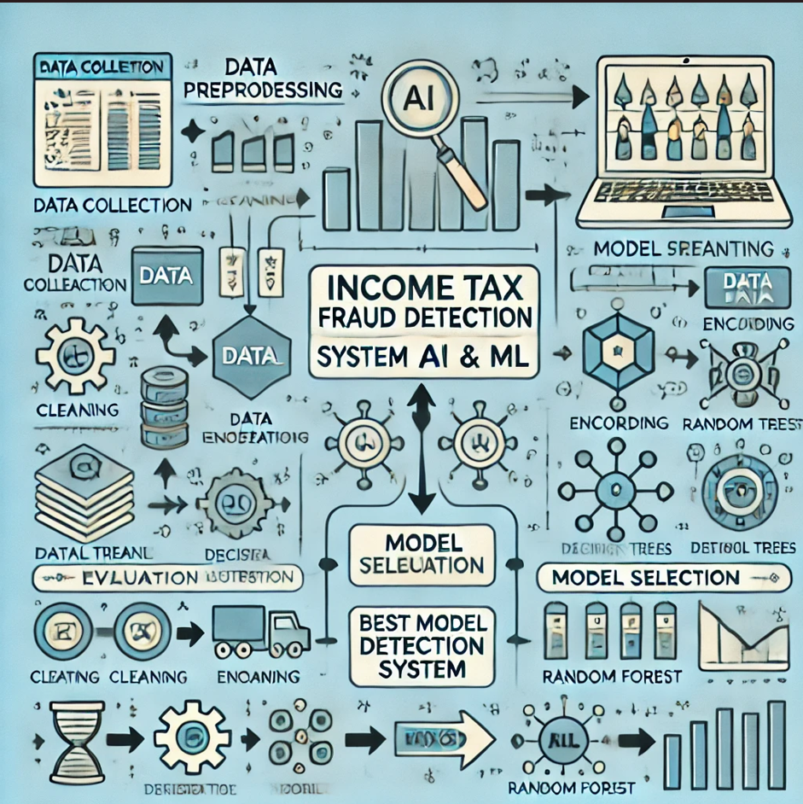
Architecture

Slide 10
Hardware/software components
Programming Language
Python for implementing AI/ML models and data processing.
Machine Learning Libraries
Scikit-learn, TensorFlow, or PyTorch for building and training models.
Data Processing Libraries
Pandas and NumPy for data manipulation and preprocessing.
Data Visualization Tools
Matplotlib and Seaborn for creating visualizations to explore data patterns.
Integrated Development Environment (IDE)
Jupyter Notebook or PyCharm for coding and testing models.
Version Control
Git for managing code versions and collaboration.

Slide 11
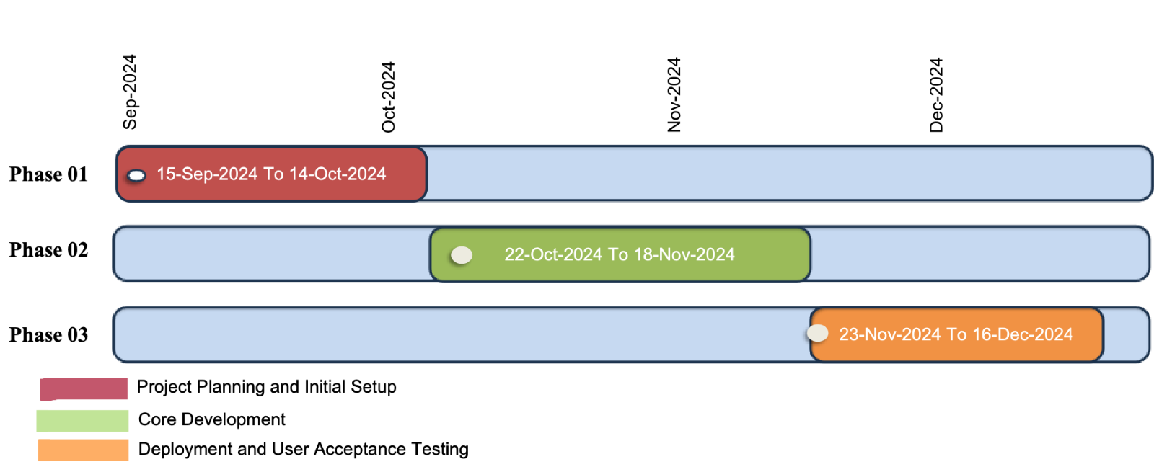
Timeline of Project

Slide 12
Expected Outcomes
Accurate Fraud Detection Model
A machine learning model capable of accurately identifying income tax fraud with high precision and reliability.
Performance Comparison
Detailed evaluation and comparison of different AI/ML models, showcasing their strengths and weaknesses for fraud detection.
Scalable Solution
A scalable and efficient system that can be adapted to larger datasets, offering real-world applicability for detecting tax fraud.
Enhanced Fraud Prevention
A proactive tool that helps in identifying fraud early, potentially reducing financial losses and improving tax system integrity.

Slide 13
Conclusion
Comprehensive Model Evaluation
The comparison of multiple models will allow us to determine the most effective approach, contributing to more reliable fraud detection systems.
Real-World Applicability
The developed system can be scaled and adapted to real-world scenarios, helping tax authorities prevent fraud and ensure compliance.
Future Scope
This project lays the foundation for further improvements, such as incorporating more advanced deep learning algorithms or integrating real-time data for continuous monitoring.

Slide 14
Github Link
GitHub Link
Income Tax Fraud Detection Idea Using AI & ML Github Link

Slide 15
References
Academic Papers
Matin N. Ashtiani, Bijan Raahemi (2021). "Intelligent Fraud Detection in Financial Statements Using Machine Learning and Data Mining: A Systematic Literature Review". DOI: 10.1109/ACCESS.2021.3096799
Rohan Kumar C L , Ali Mohammed Zain , Sanjay Kumar H P , Prajwal A V , Dr. Sudarshan R(2022). "Comparative Study of Machine Learning Algorithms for Fraud Detection in Blockchain". DOI: 10.48175/IJARSCT-5474
Government Reports and Publications
U.S Government Accountability Office (GAO) ."Artificial Intelligence May Help IRS Close the Tax Gap"

Slide 16

Project work mapping with SDG
Goal 16: Peace, Justice, and Strong Institutions
Reduces corruption and enhances transparency in financial systems through effective fraud detection.
Goal 8: Decent Work and Economic Growth
Maintains fair tax systems, ensuring government revenue supports public services and job creation.
Goal 9: Industry, Innovation, and Infrastructure
Fosters innovation by utilizing AI and ML, upgrading technological capabilities in financial sectors.
Goal 1: No Poverty
Promotes efficient resource allocation, potentially reducing economic burdens on low-income households.

Slide 17
Thank You

